Slide 1
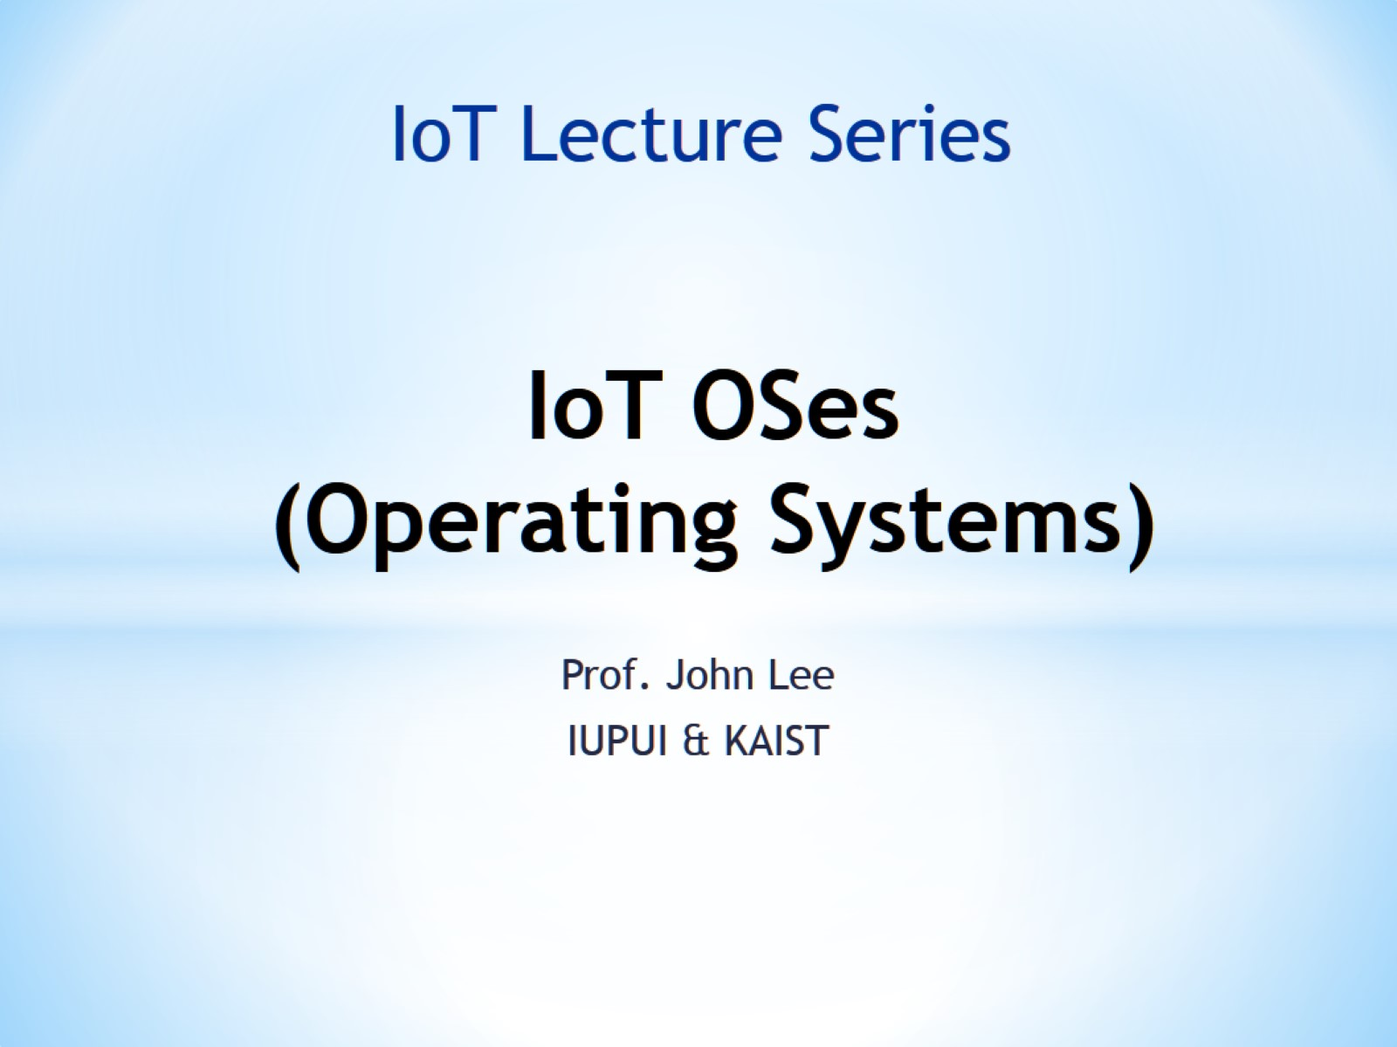
IoT OSes (Operating Systems)

Slide 2
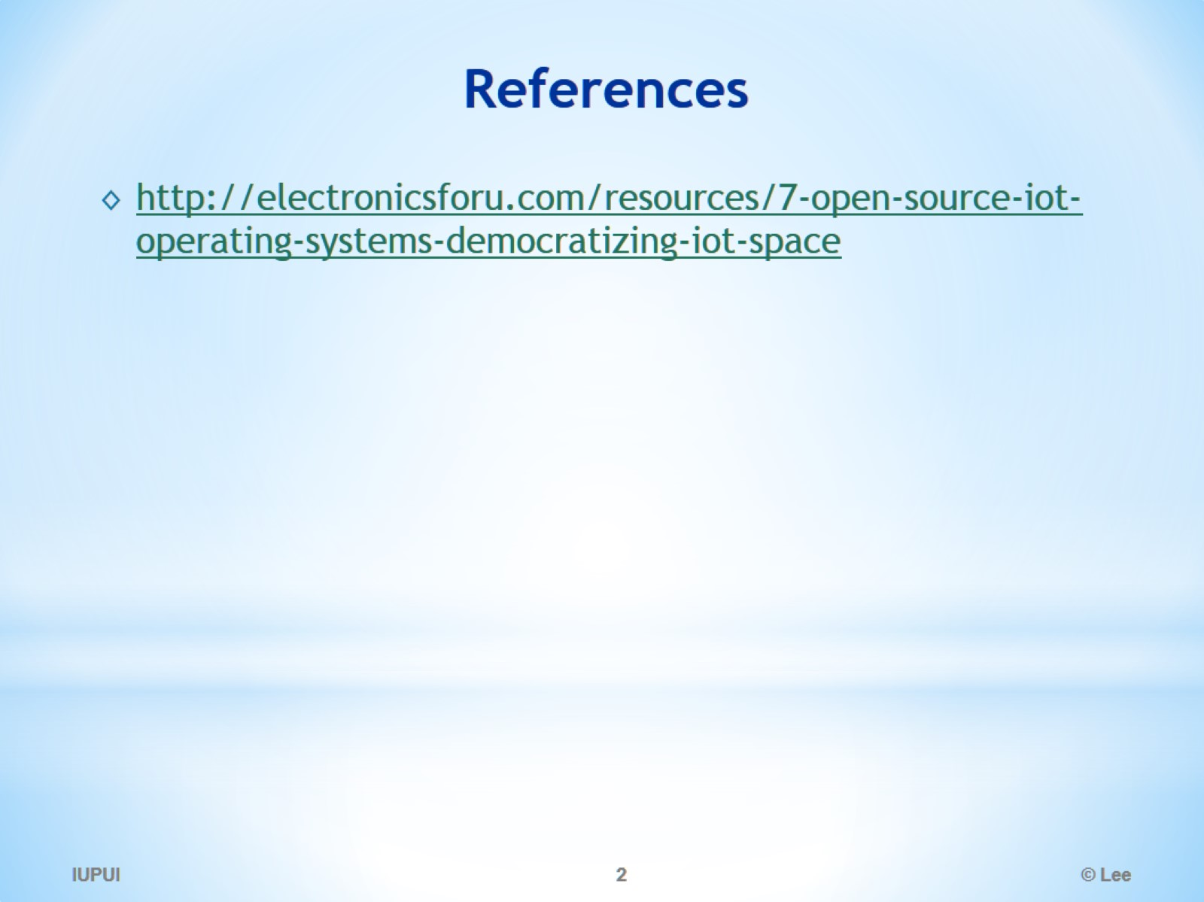
References

Slide 3
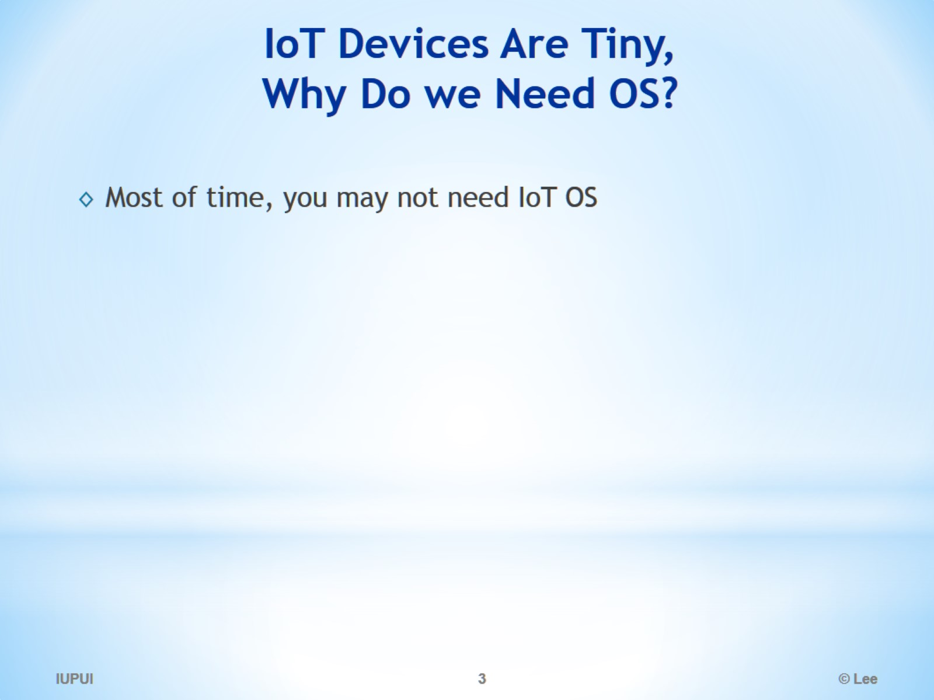
IoT Devices Are Tiny, Why Do we Need OS?

Slide 4
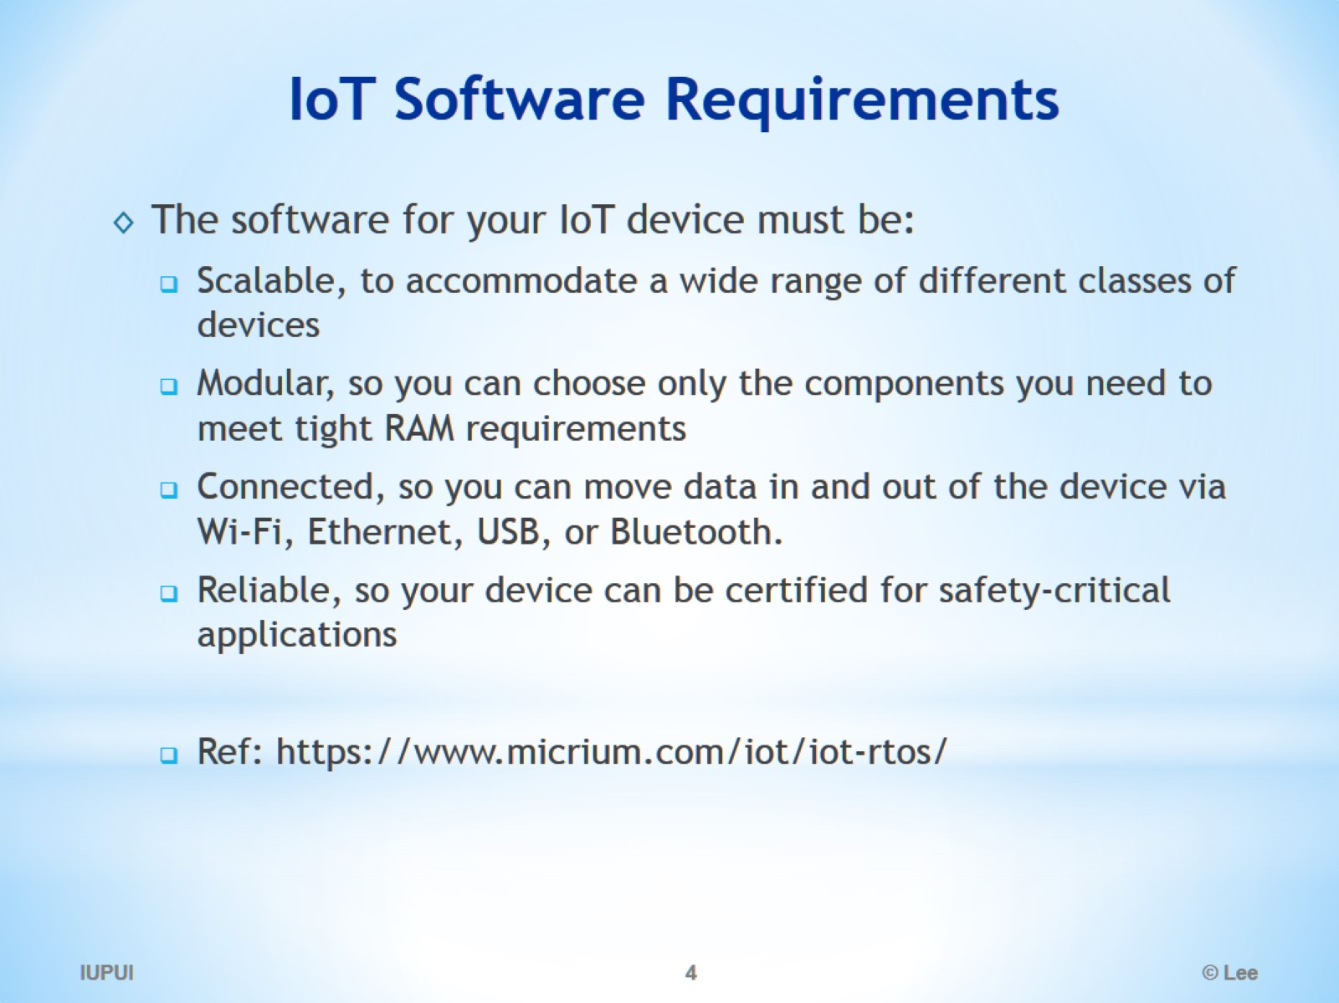
IoT Software Requirements

Slide 5
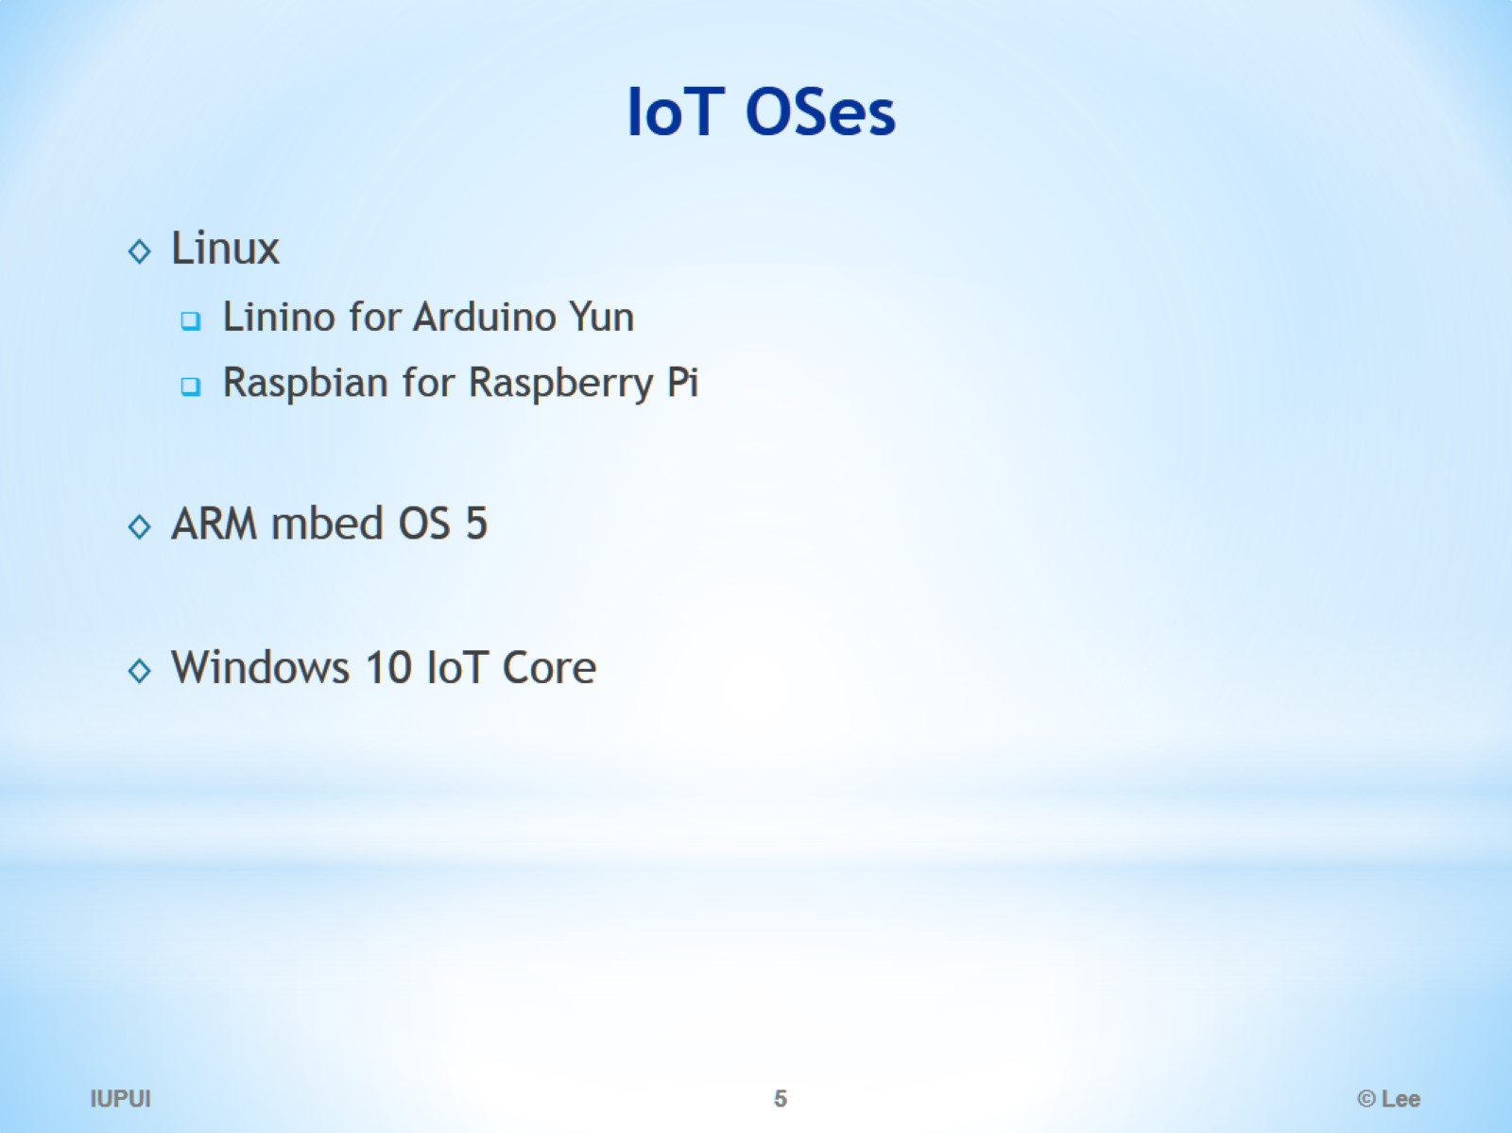
IoT OSes

Slide 6
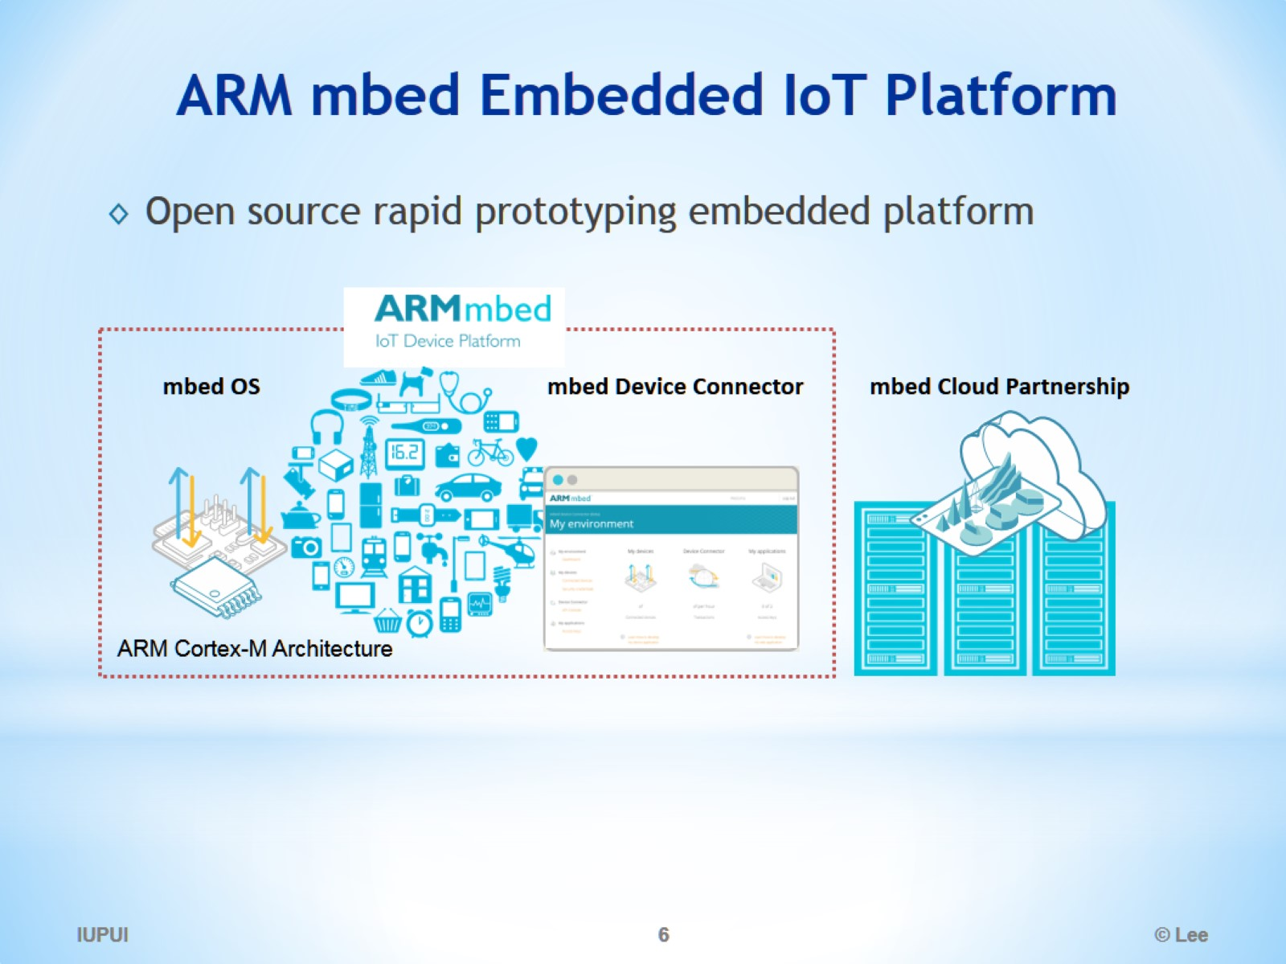
ARM mbed Embedded IoT Platform

Slide 7
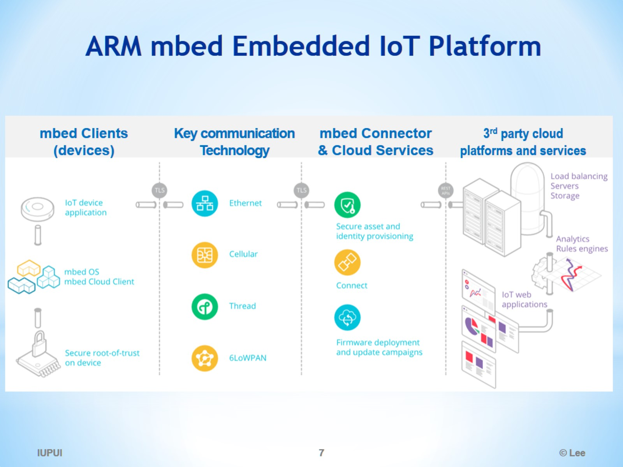
ARM mbed Embedded IoT Platform

Slide 8
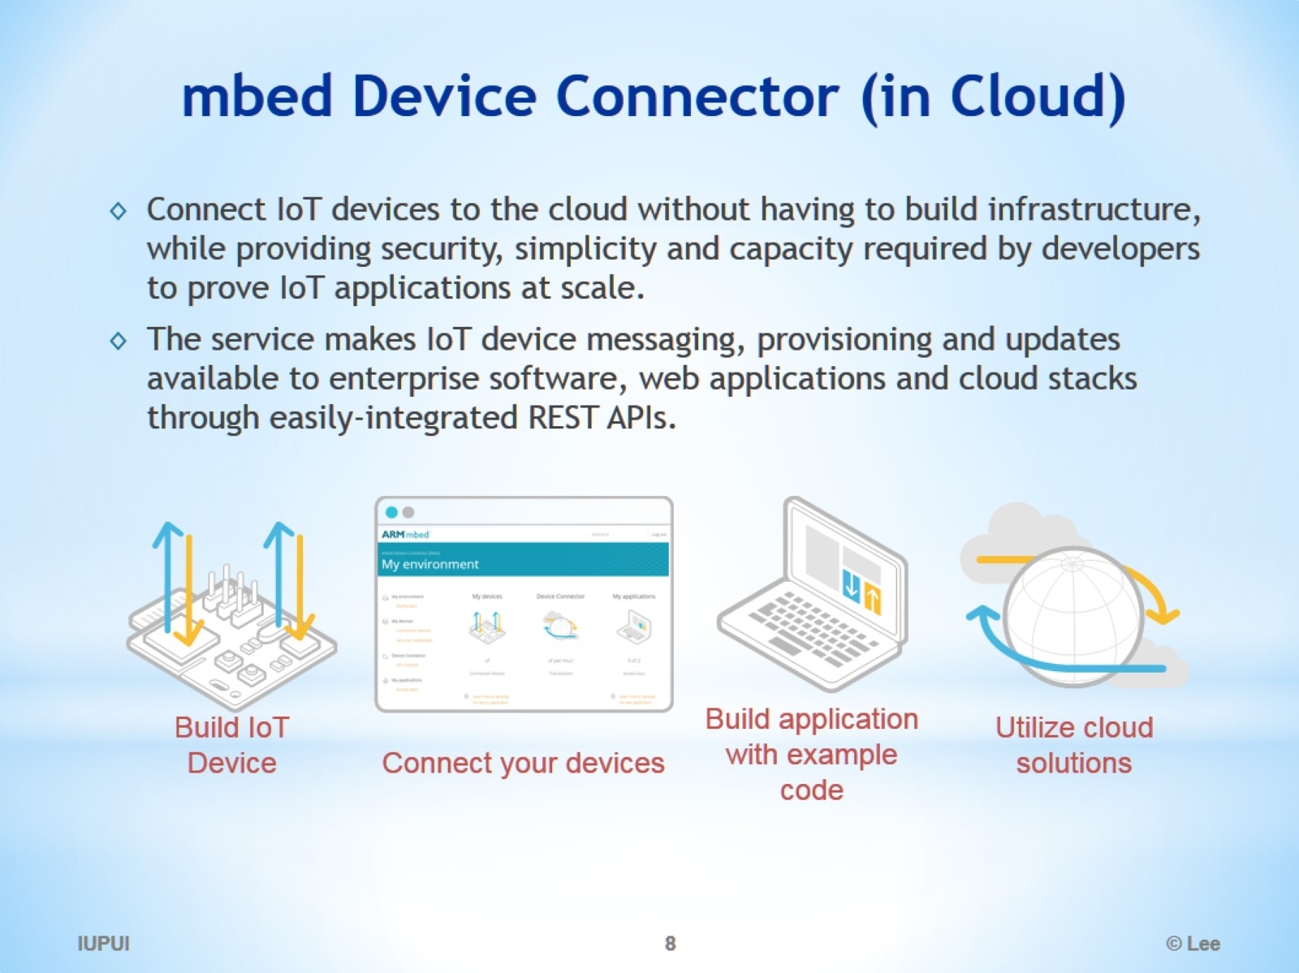
mbed Device Connector (in Cloud)

Slide 9
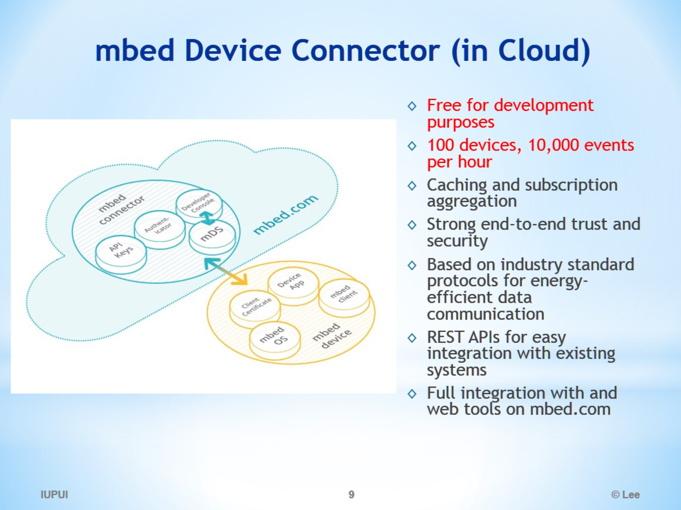
mbed Device Connector (in Cloud)

Slide 10
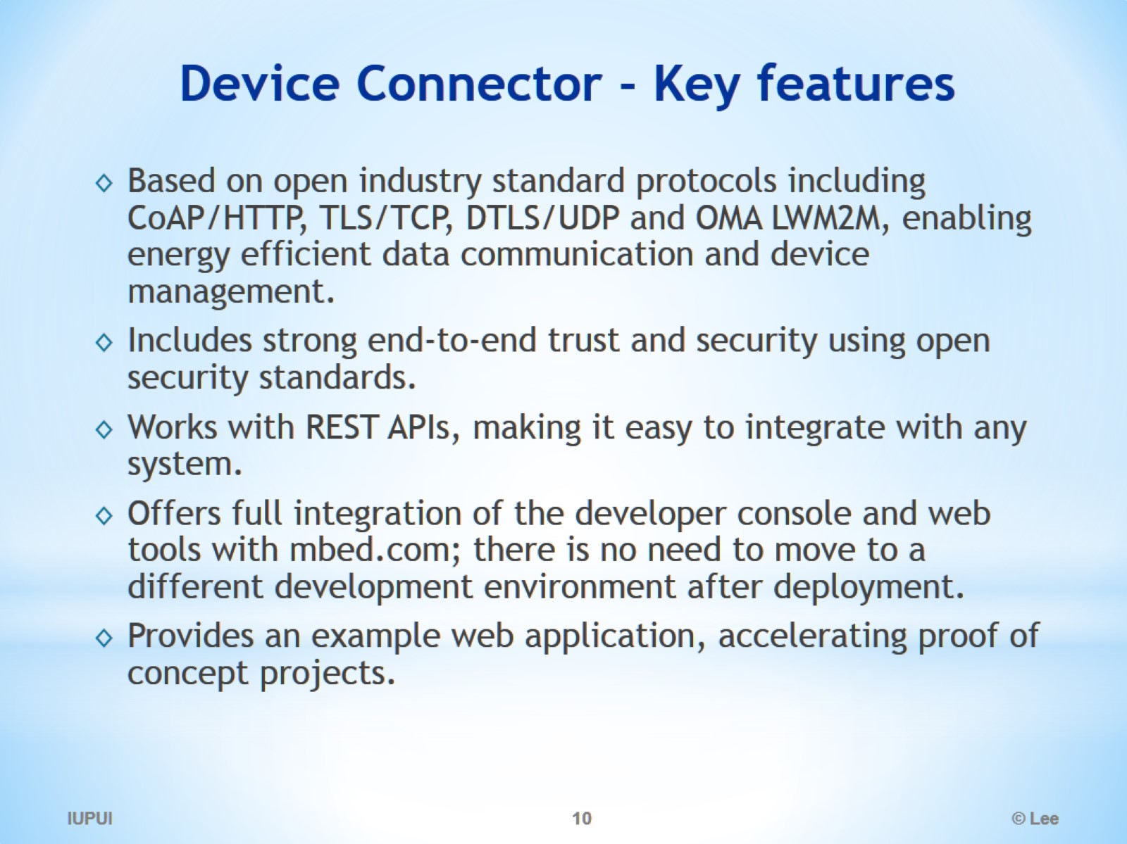
Device Connector - Key features

Slide 11
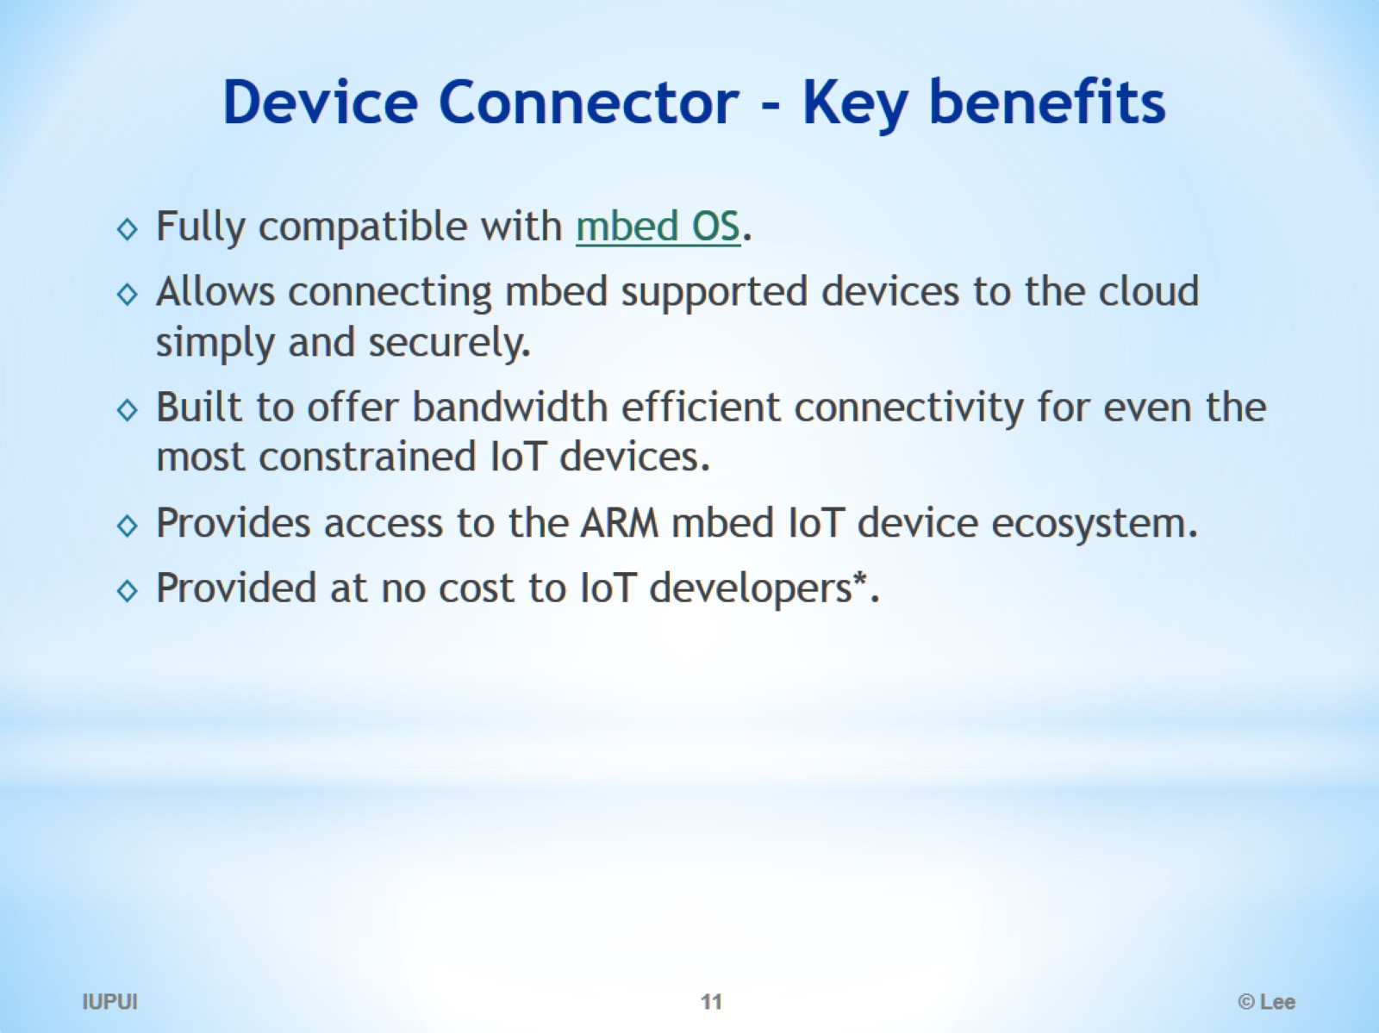
Device Connector - Key benefits

Slide 12
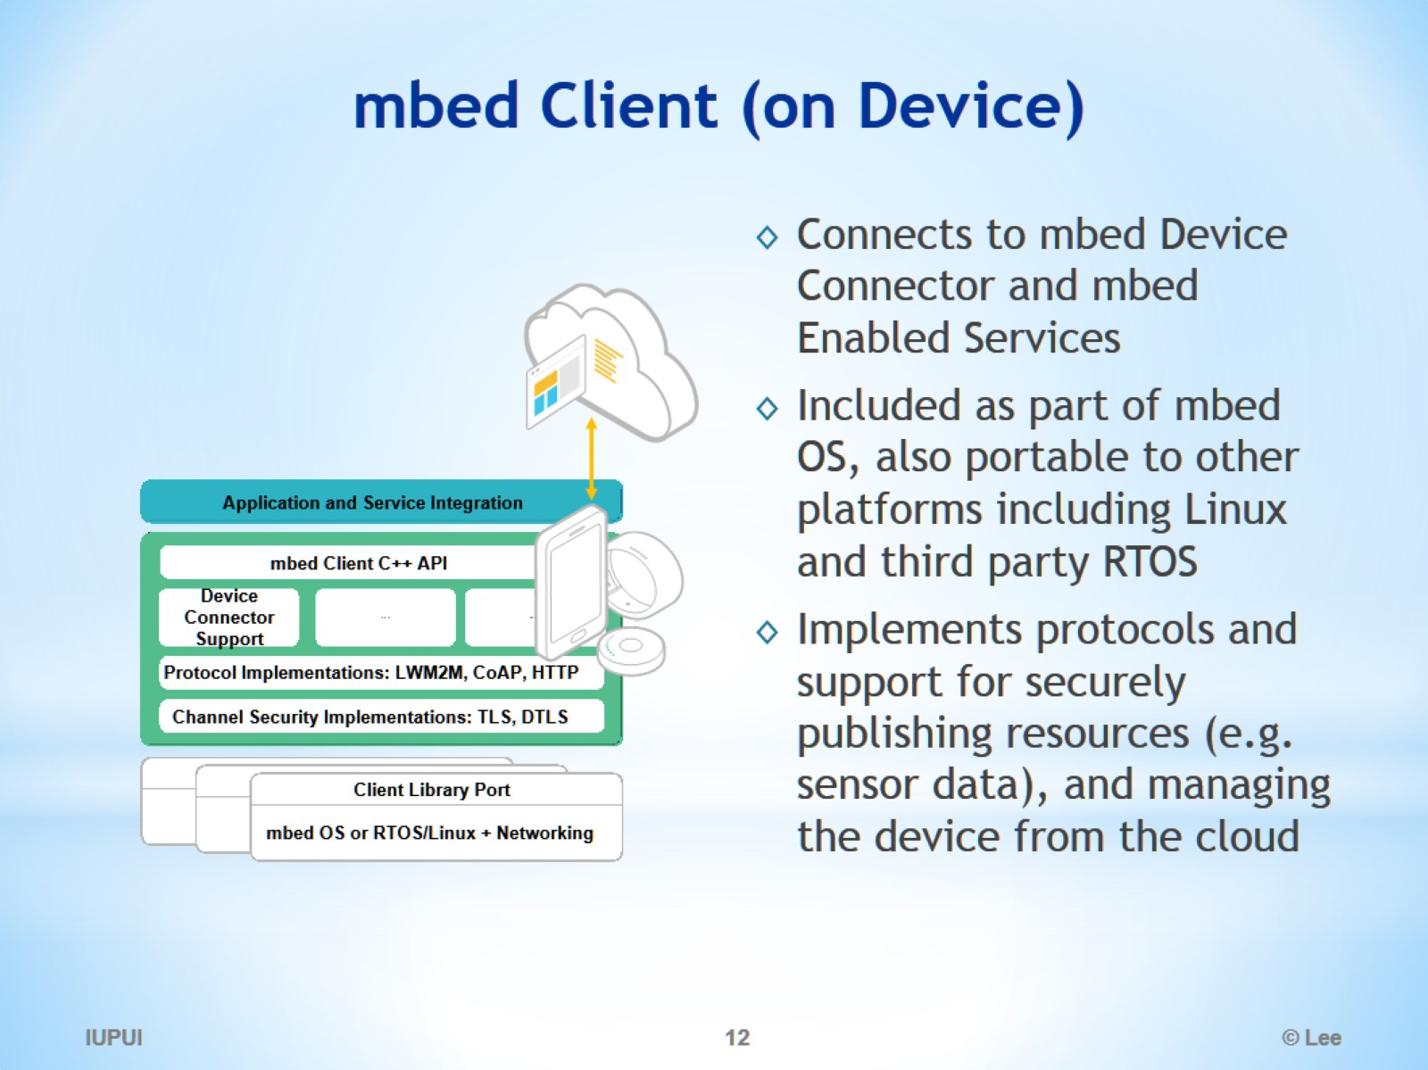
mbed Client (on Device)

Slide 13
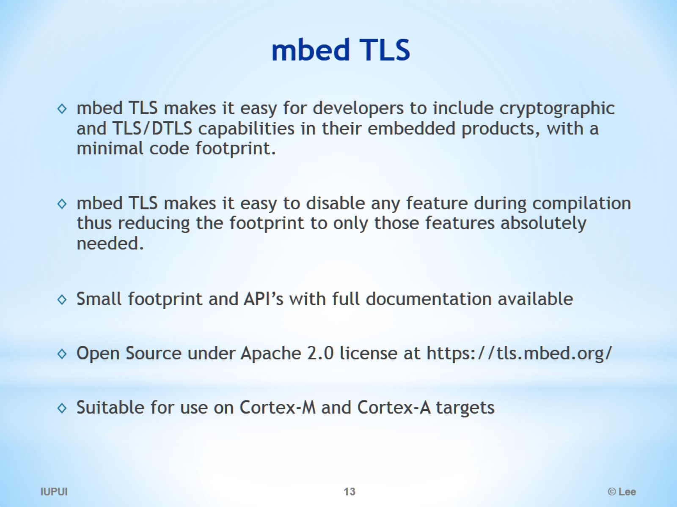
mbed TLS

Slide 14
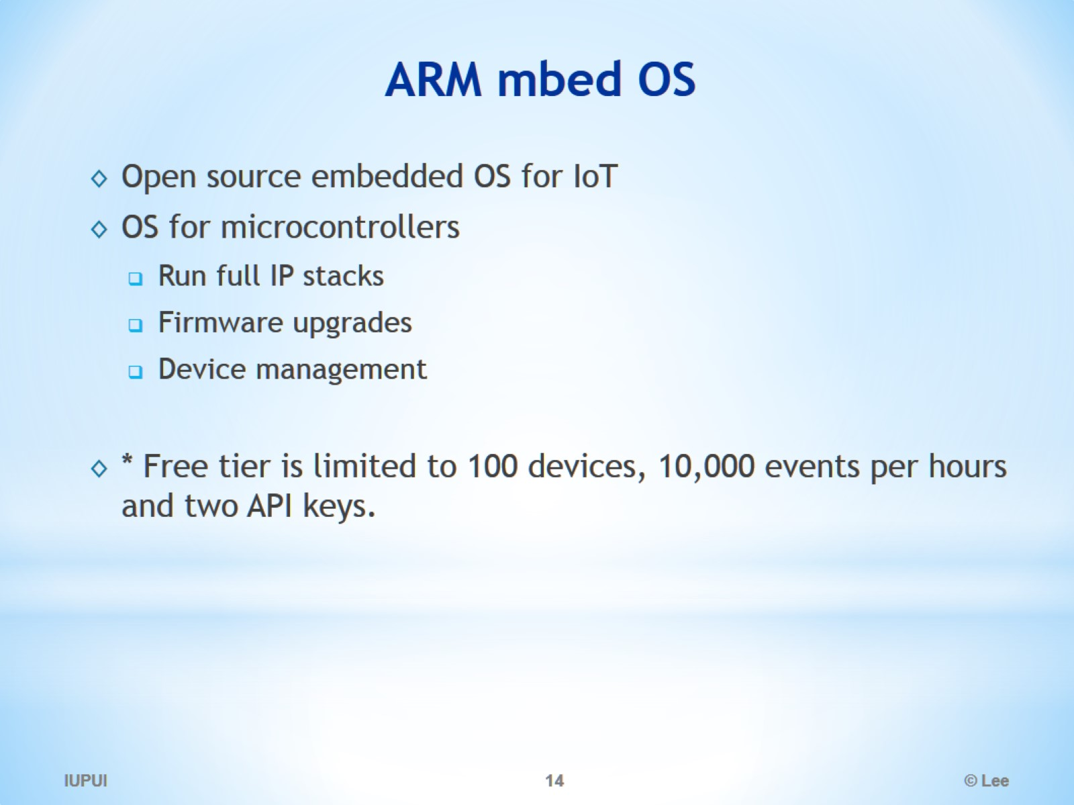
ARM mbed OS

Slide 15
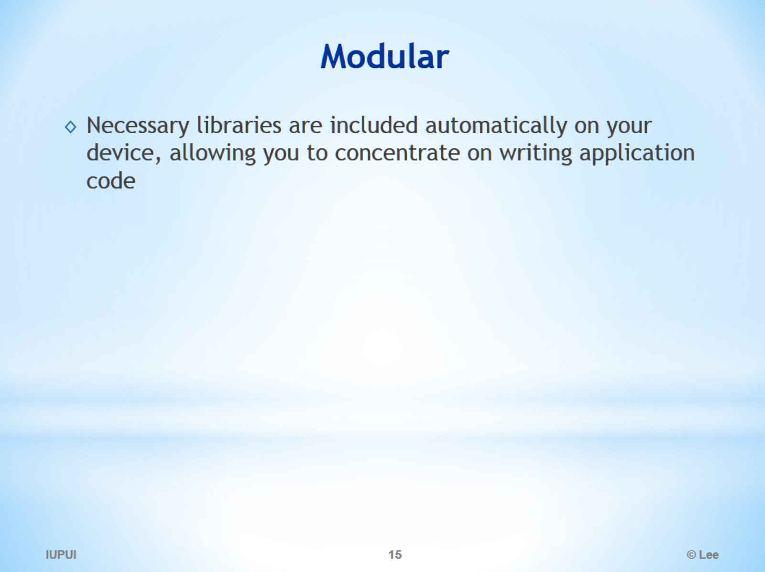
Modular

Slide 16
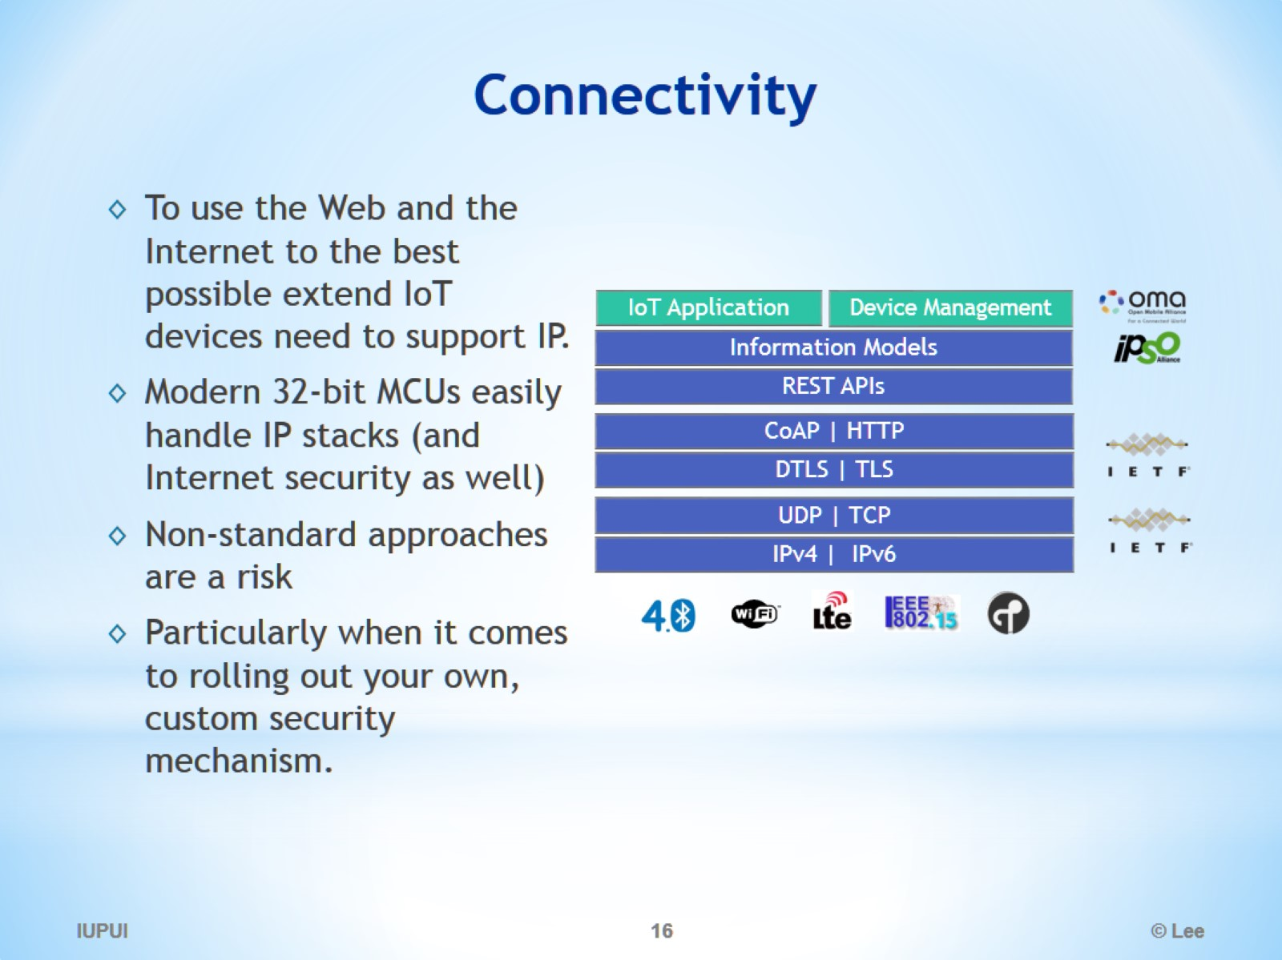
Connectivity

Slide 17
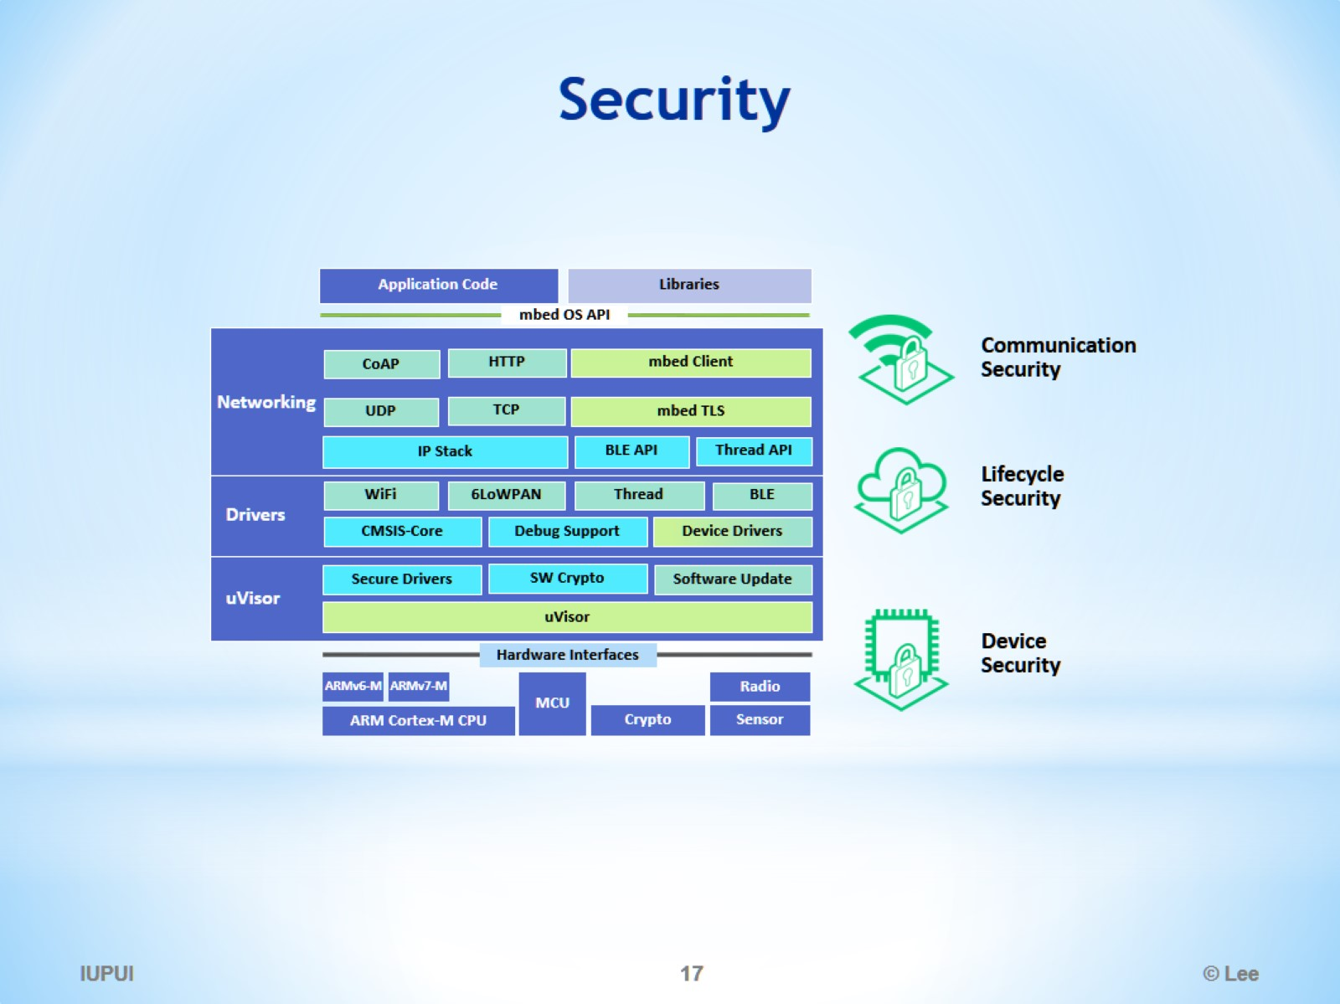
Security

Slide 18
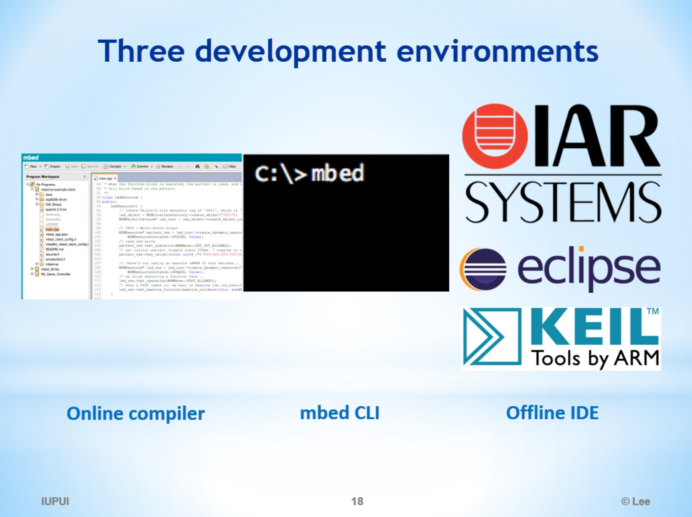
Three development environments

Slide 19
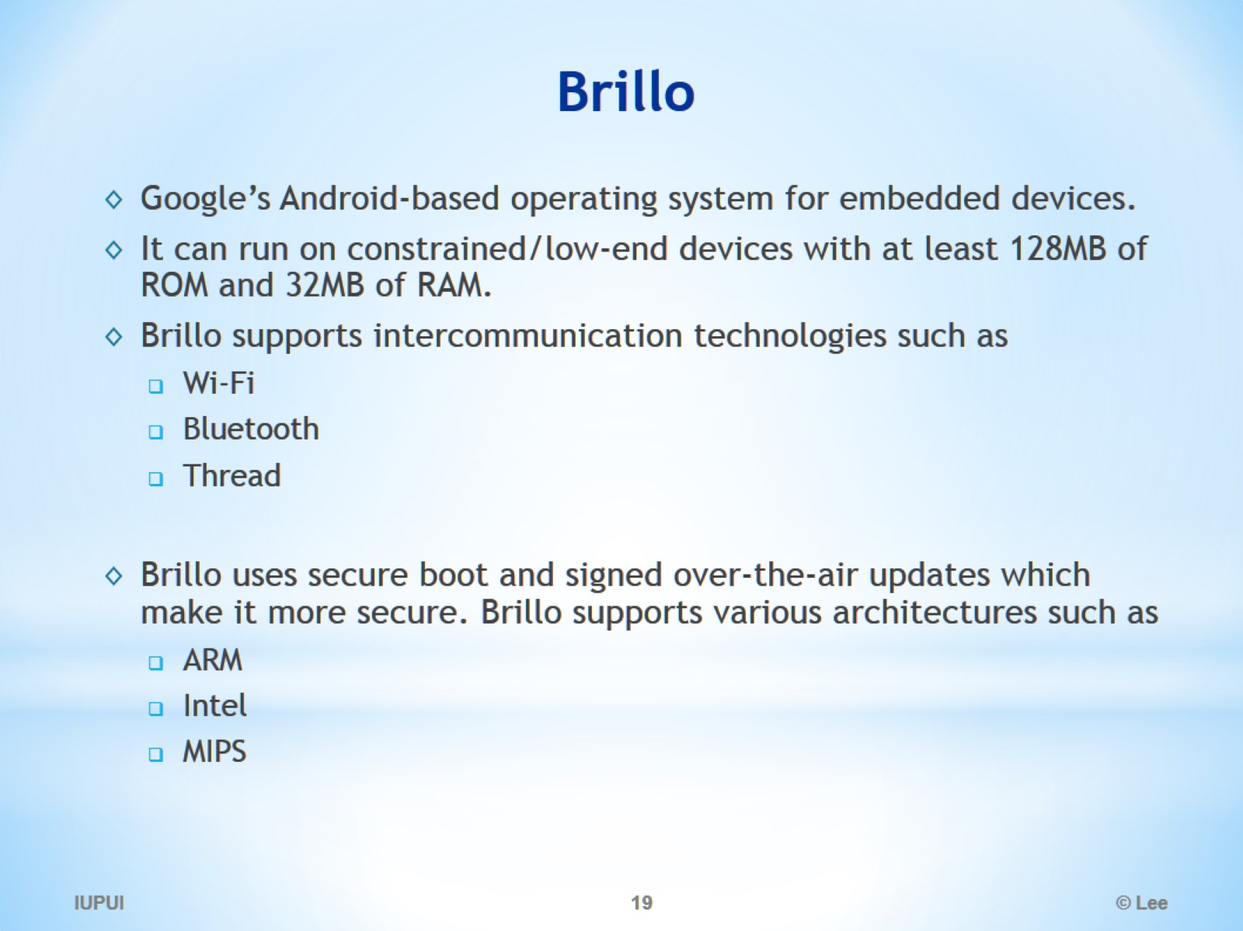
Brillo

Slide 20
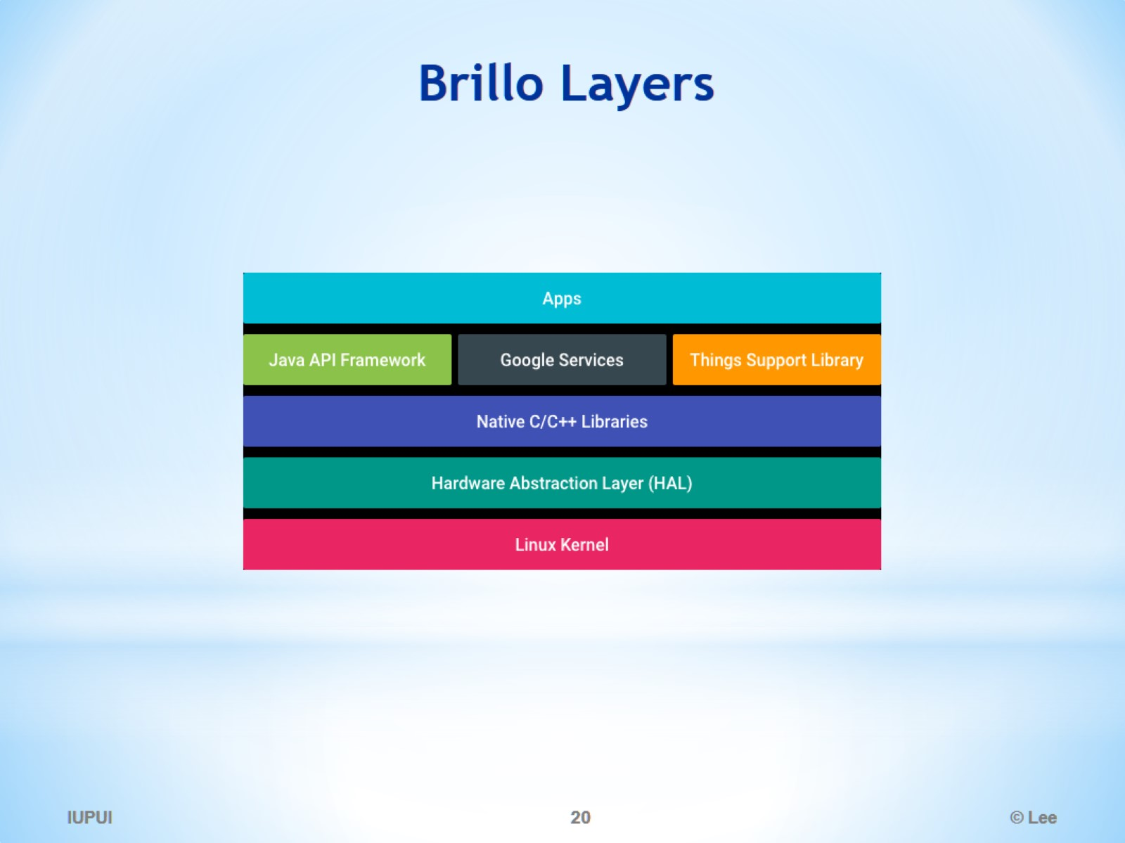
Brillo Layers

Slide 21
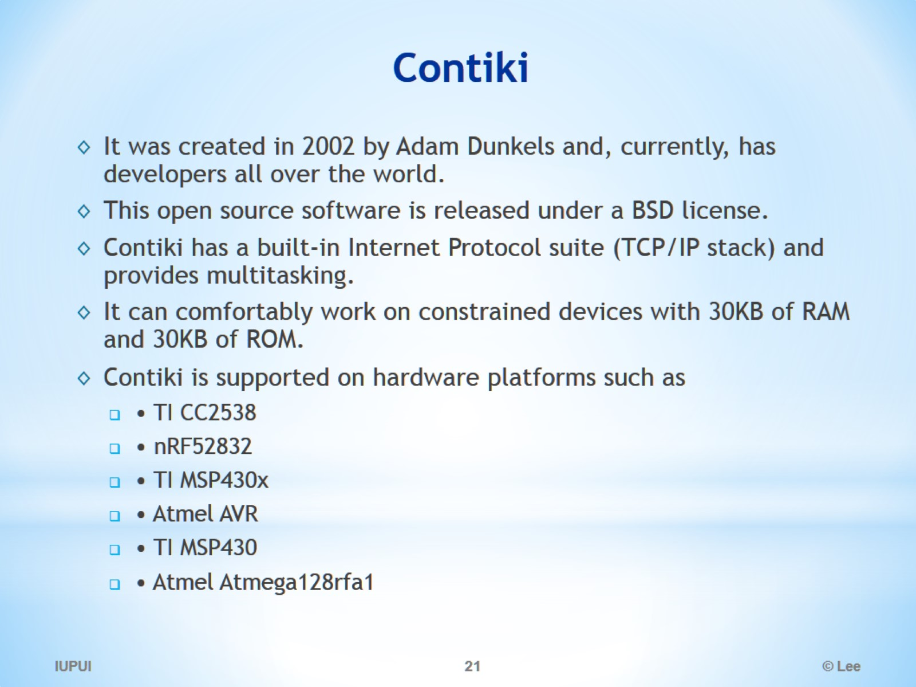
Contiki

Slide 22
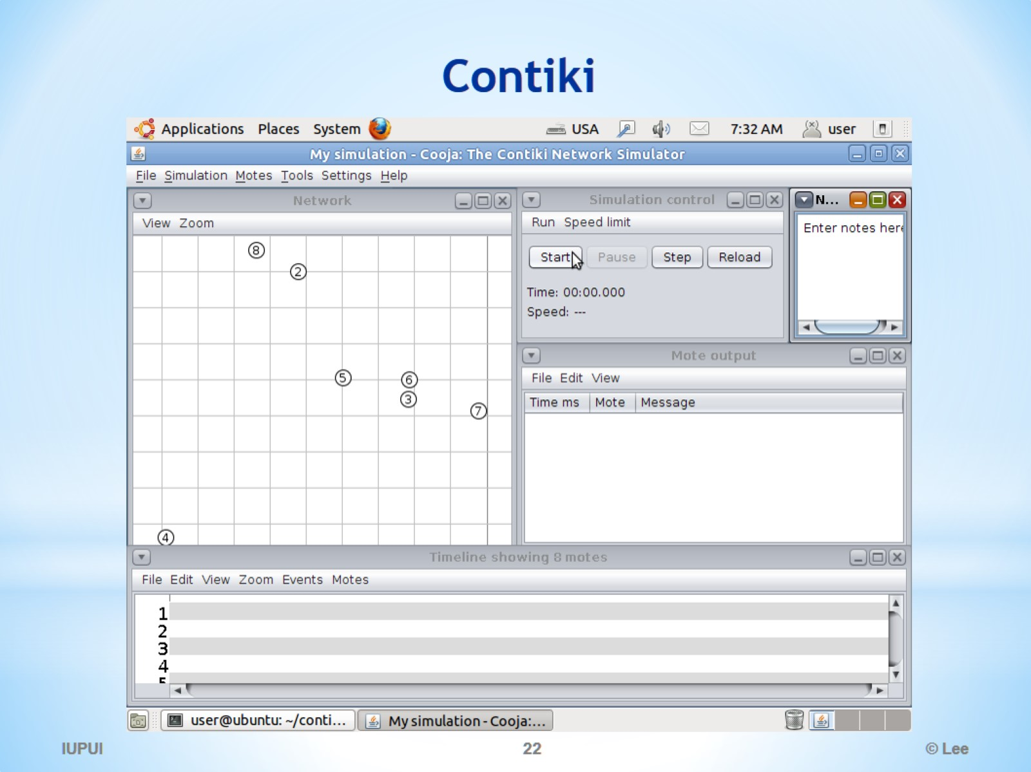
Contiki

Slide 23
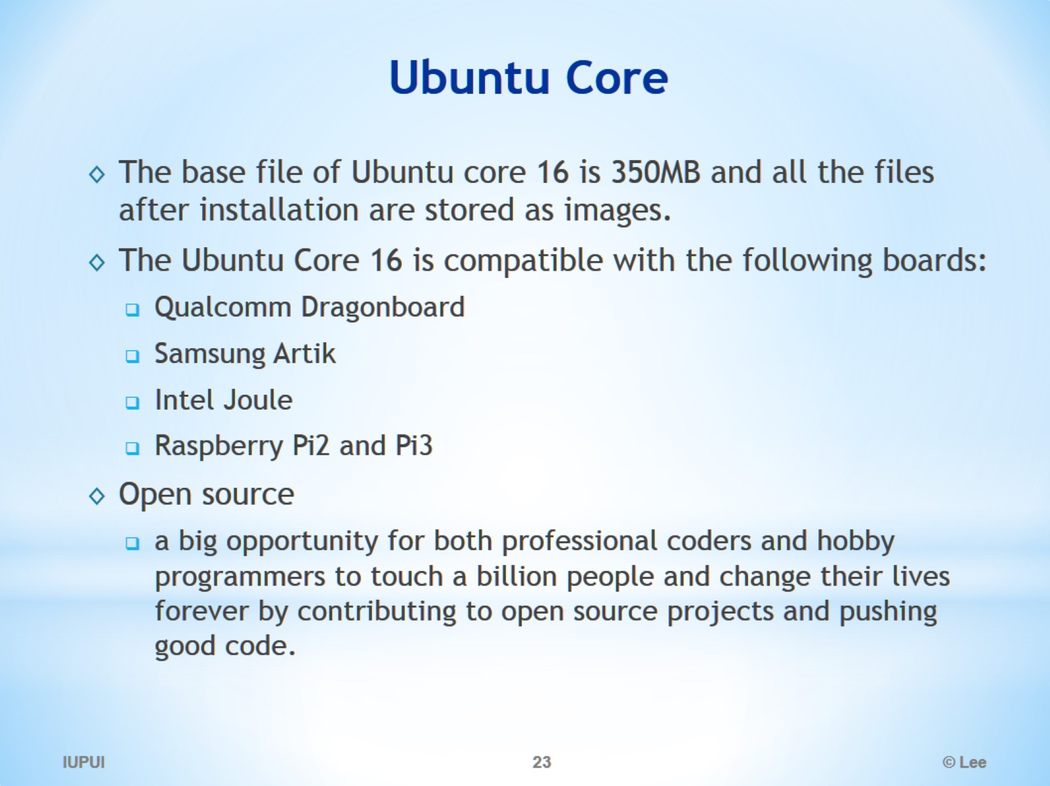
Ubuntu Core

Slide 24
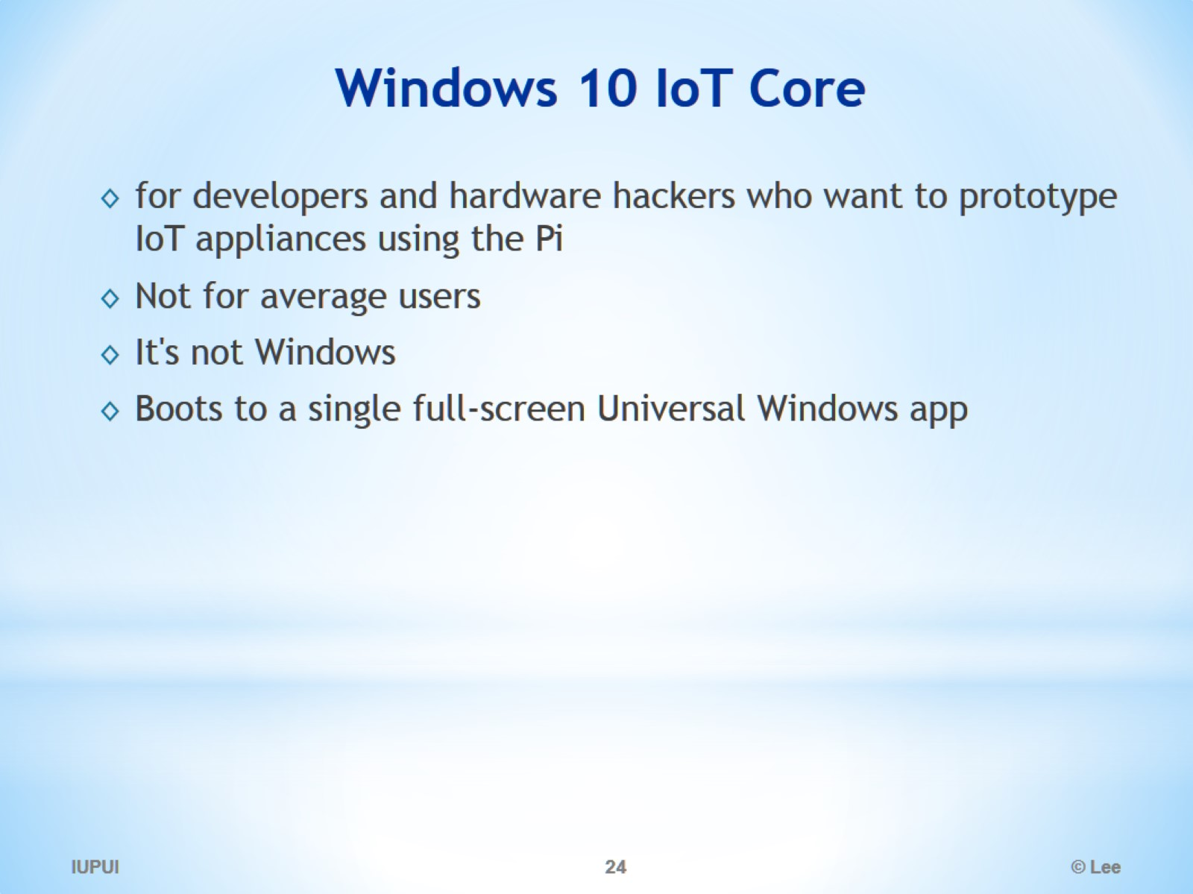
Windows 10 IoT Core

Slide 25
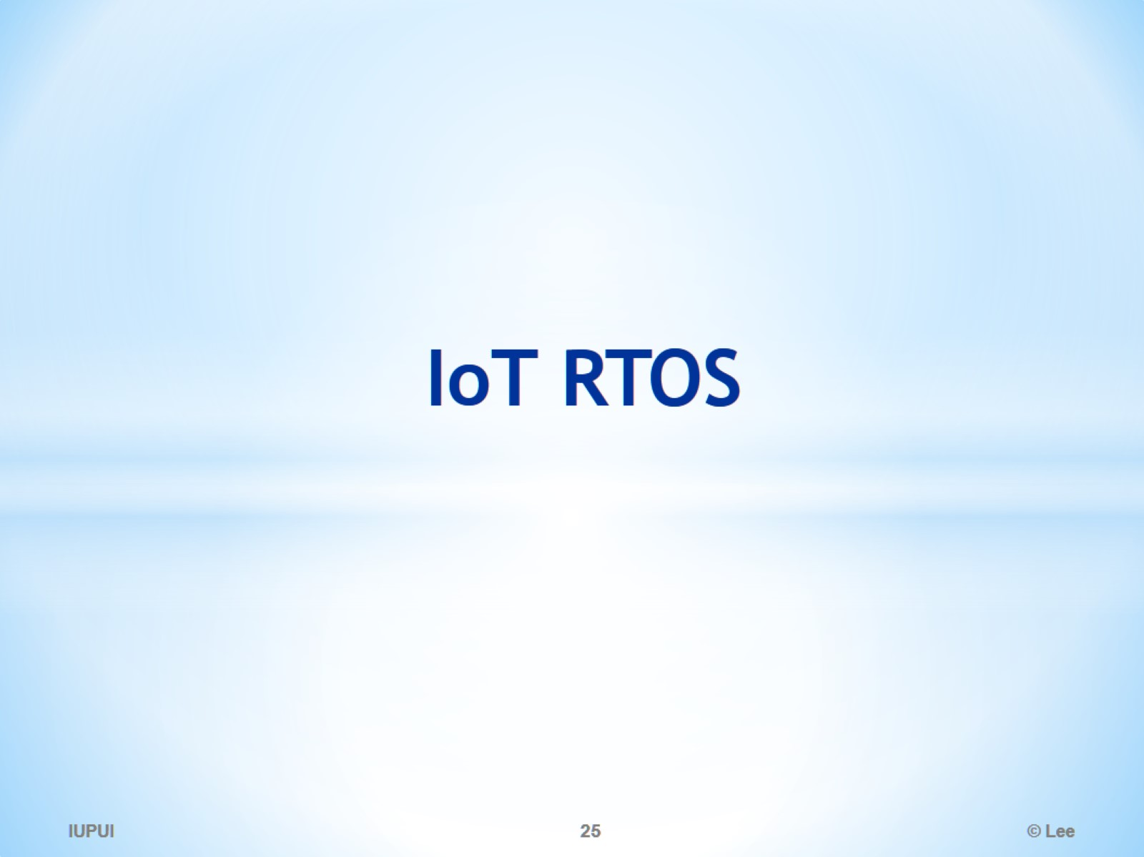
IoT RTOS

Slide 26
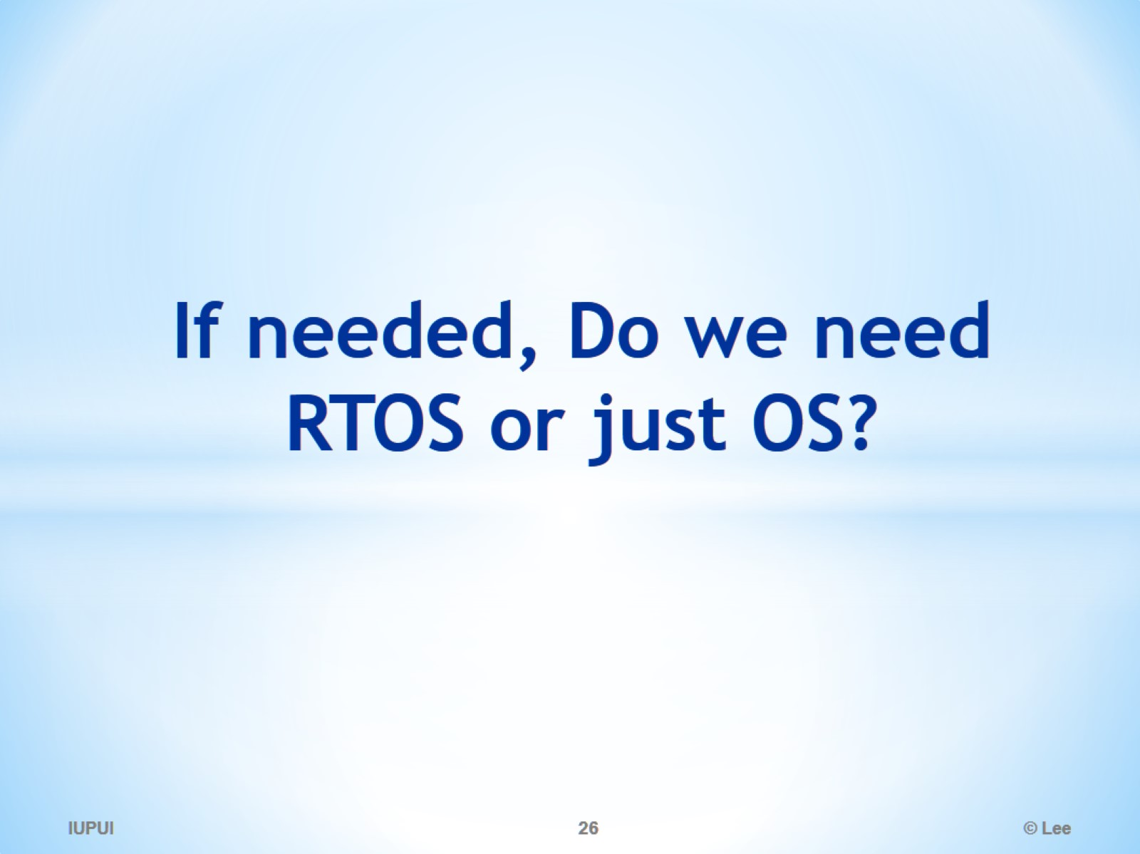
If needed, Do we need RTOS or just OS?

Slide 27
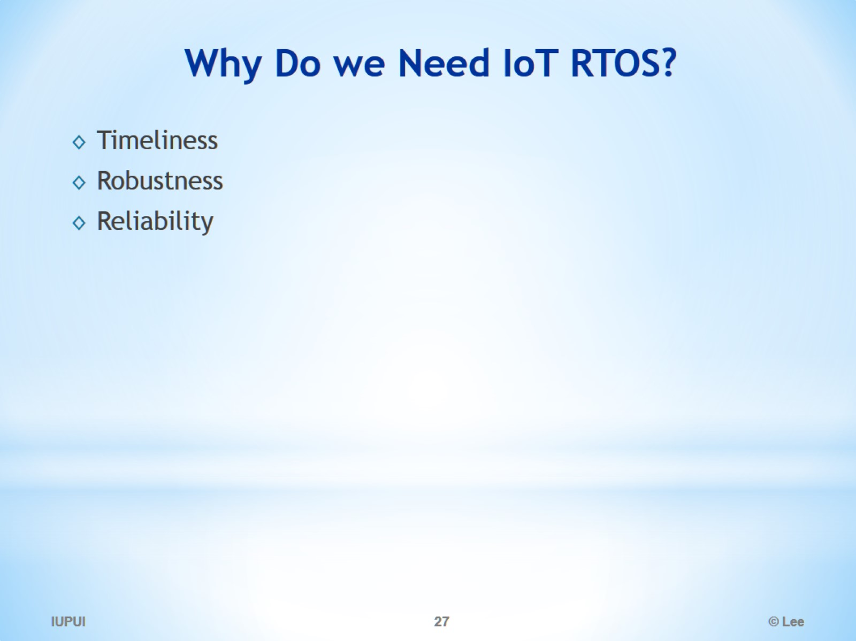
Why Do we Need IoT RTOS?

Slide 28
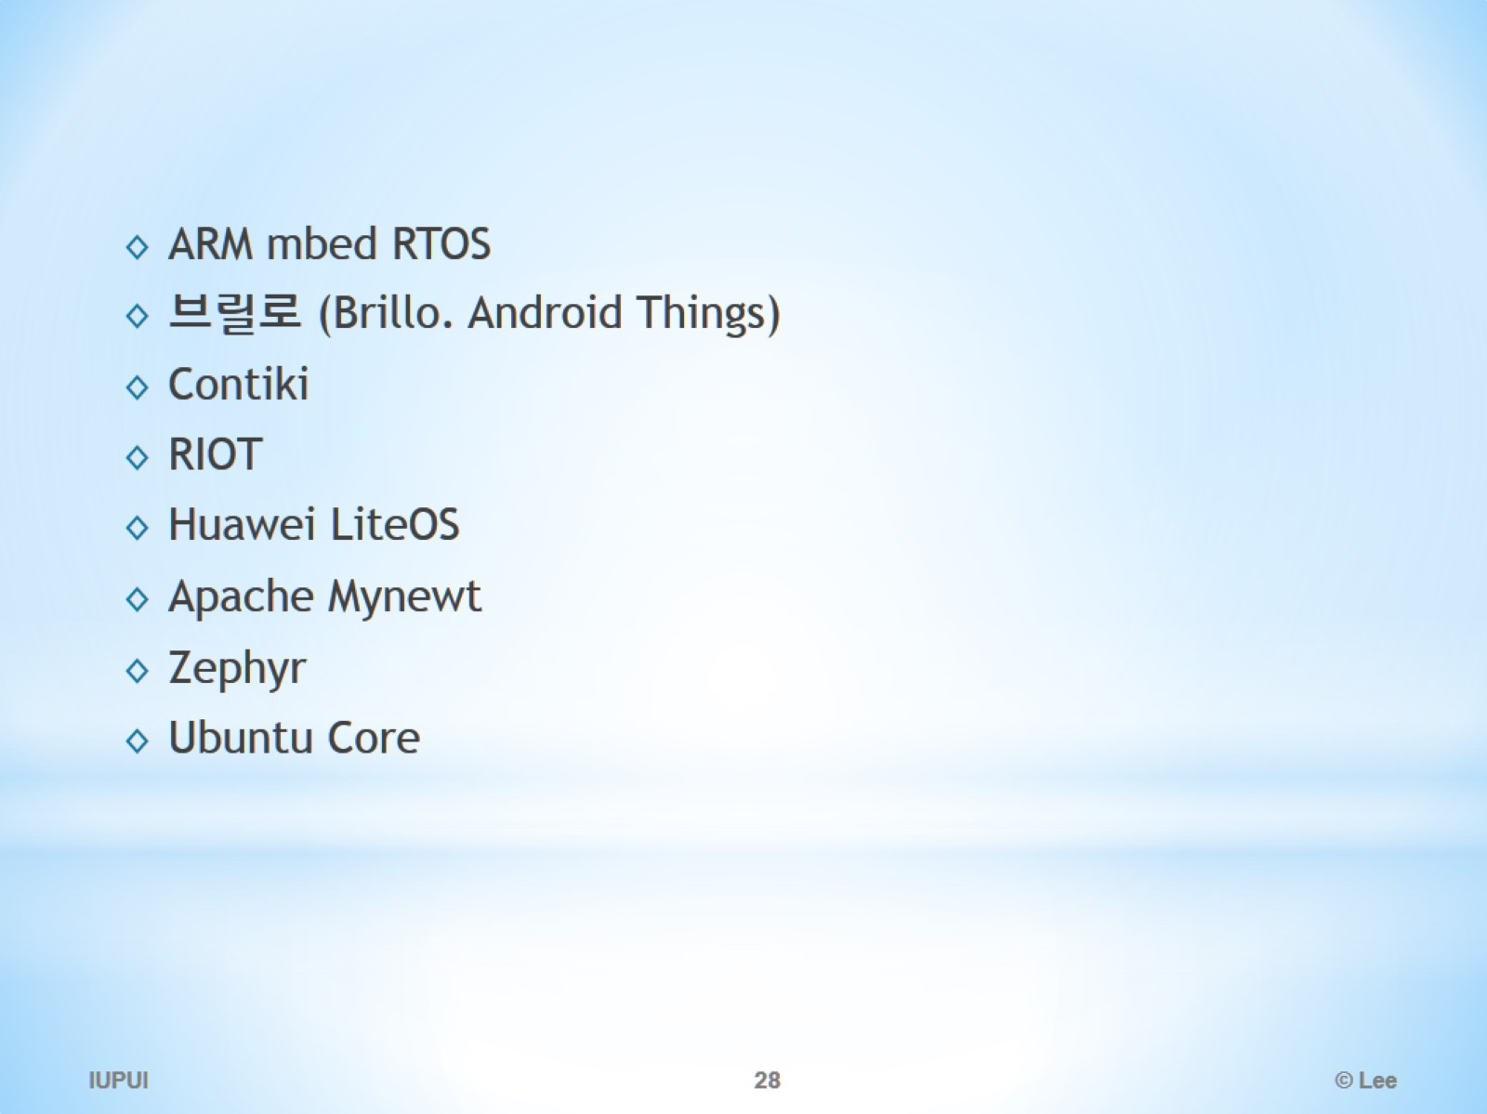

Slide 29
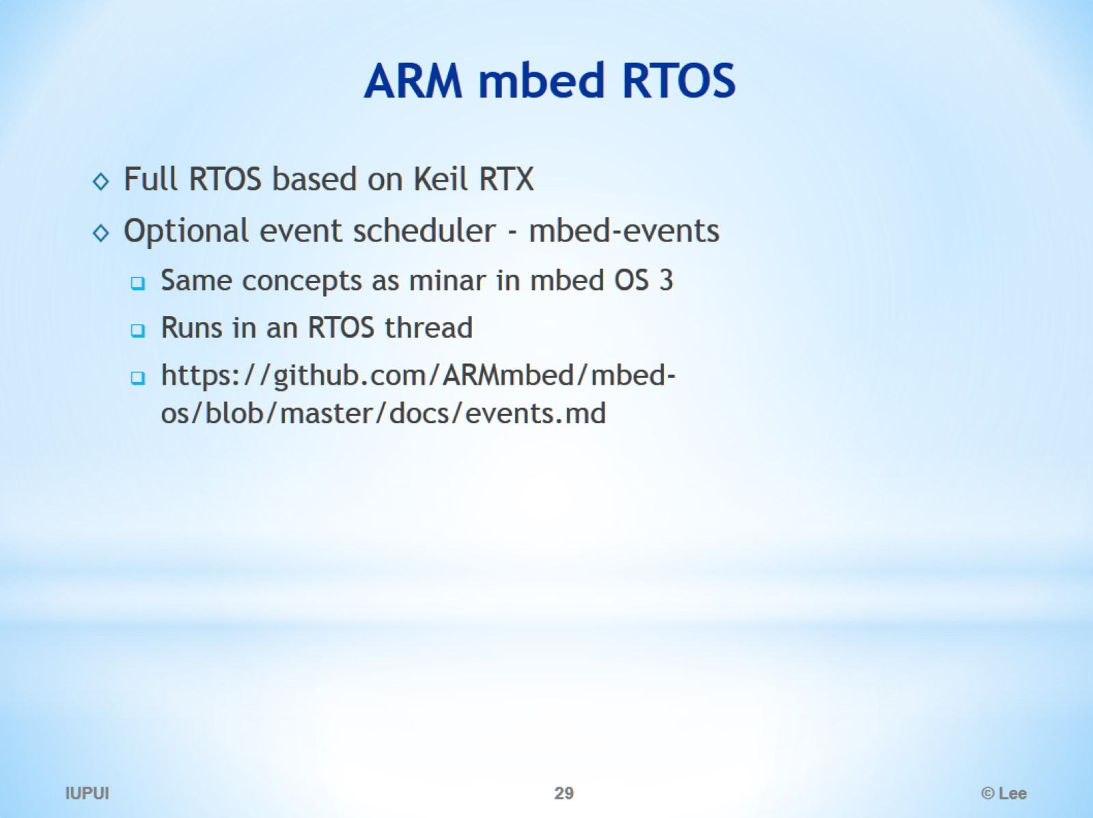
ARM mbed RTOS

Slide 30
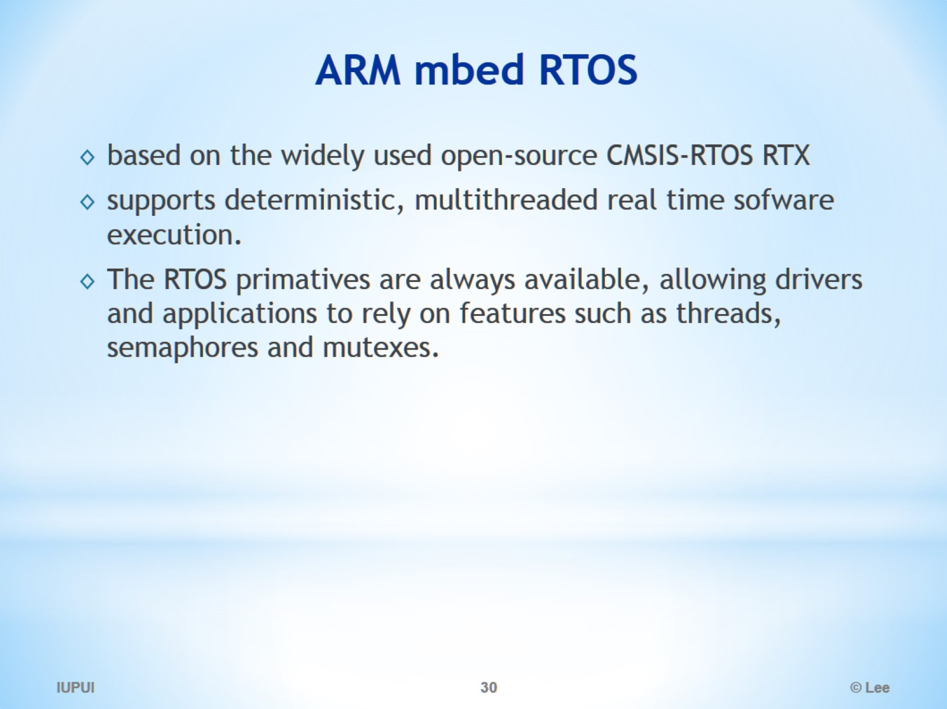
ARM mbed RTOS

Slide 31
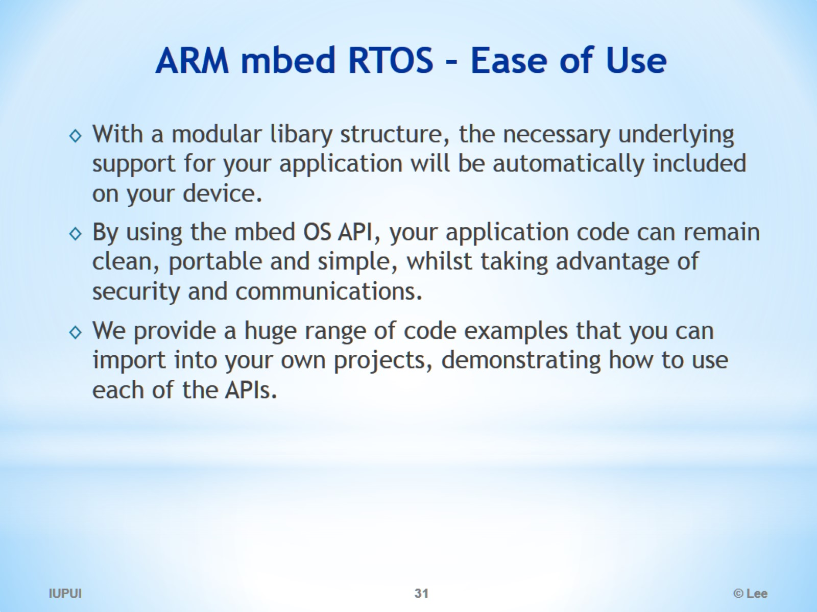
ARM mbed RTOS – Ease of Use

Slide 32
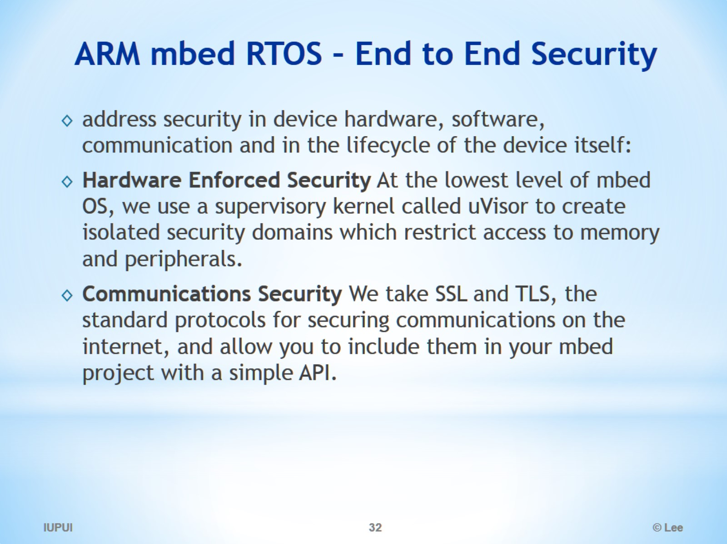
ARM mbed RTOS – End to End Security

Slide 33
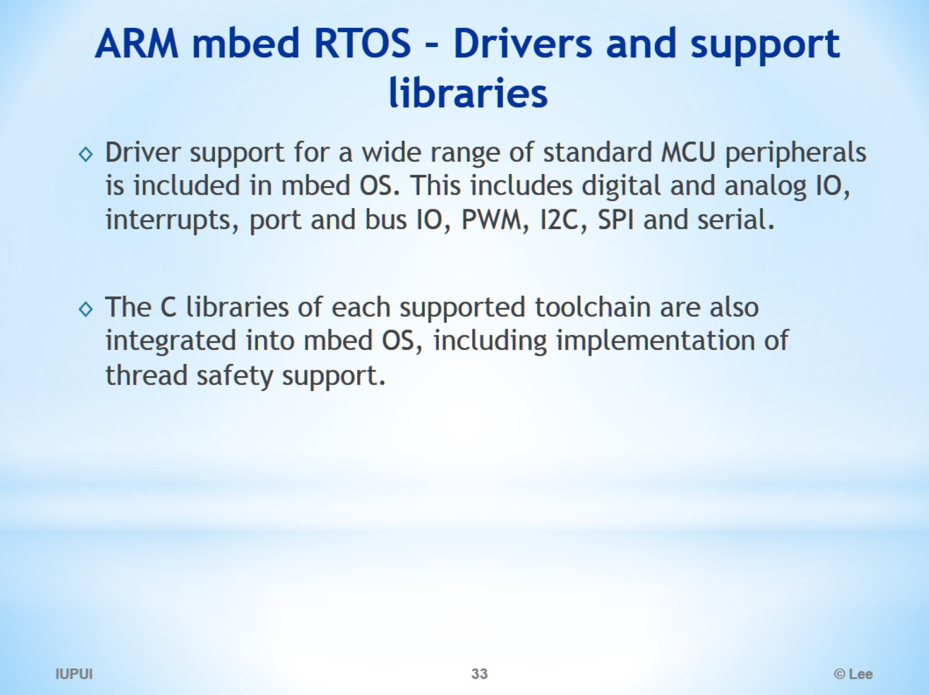
ARM mbed RTOS – Drivers and support libraries

Slide 34
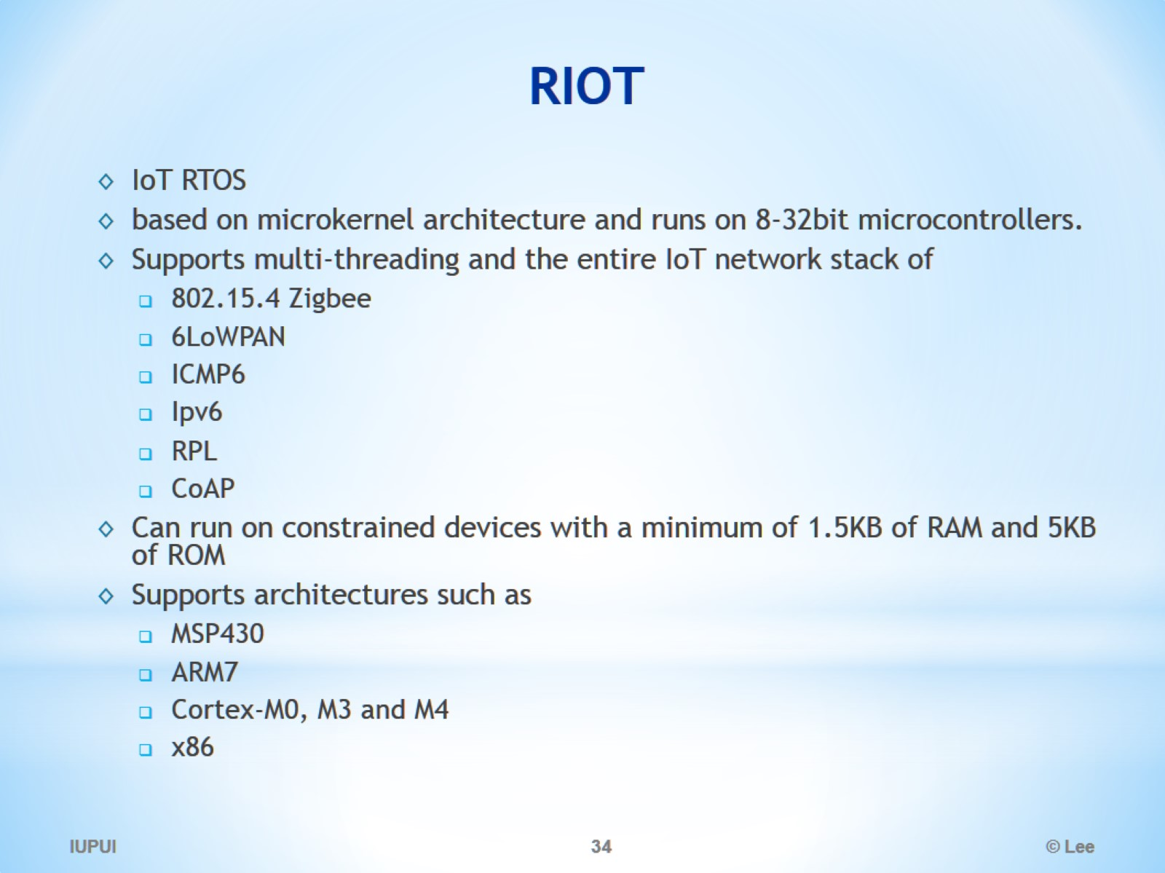
RIOT

Slide 35
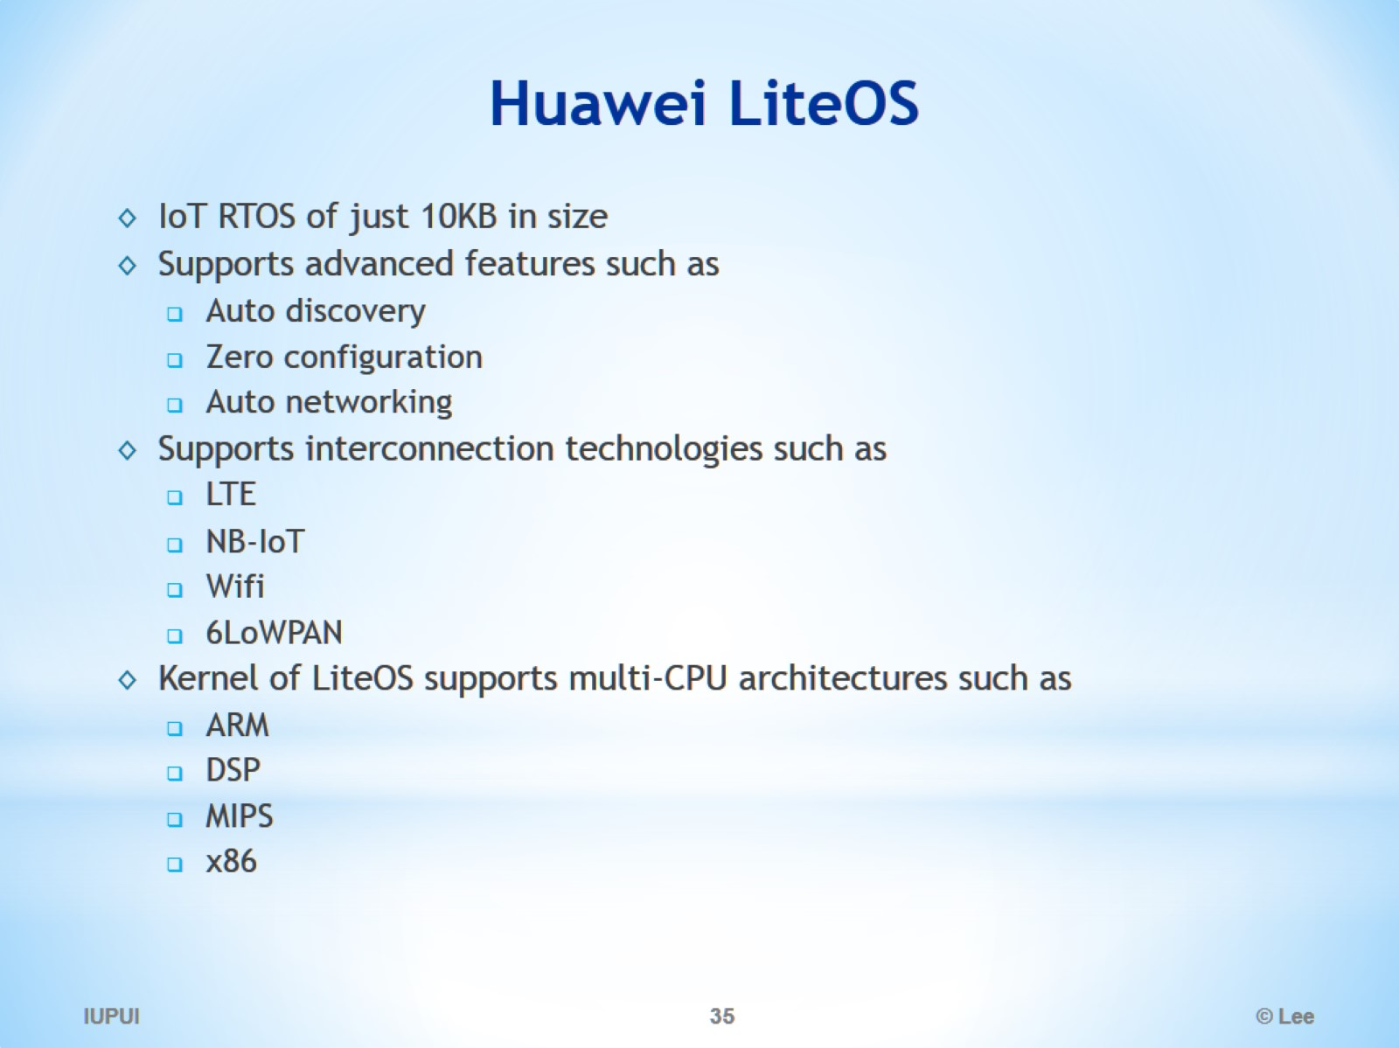
Huawei LiteOS

Slide 36
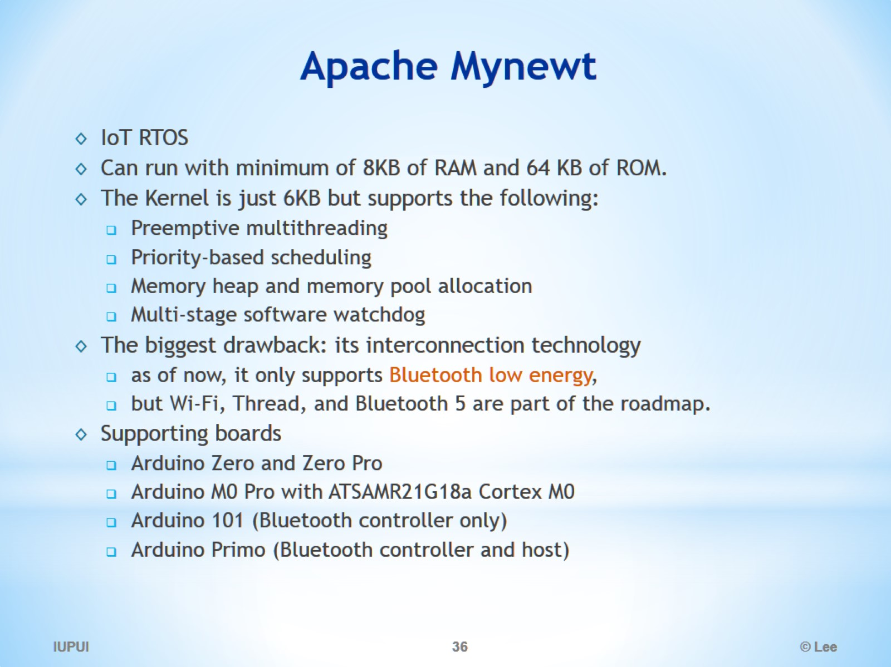
Apache Mynewt

Slide 37
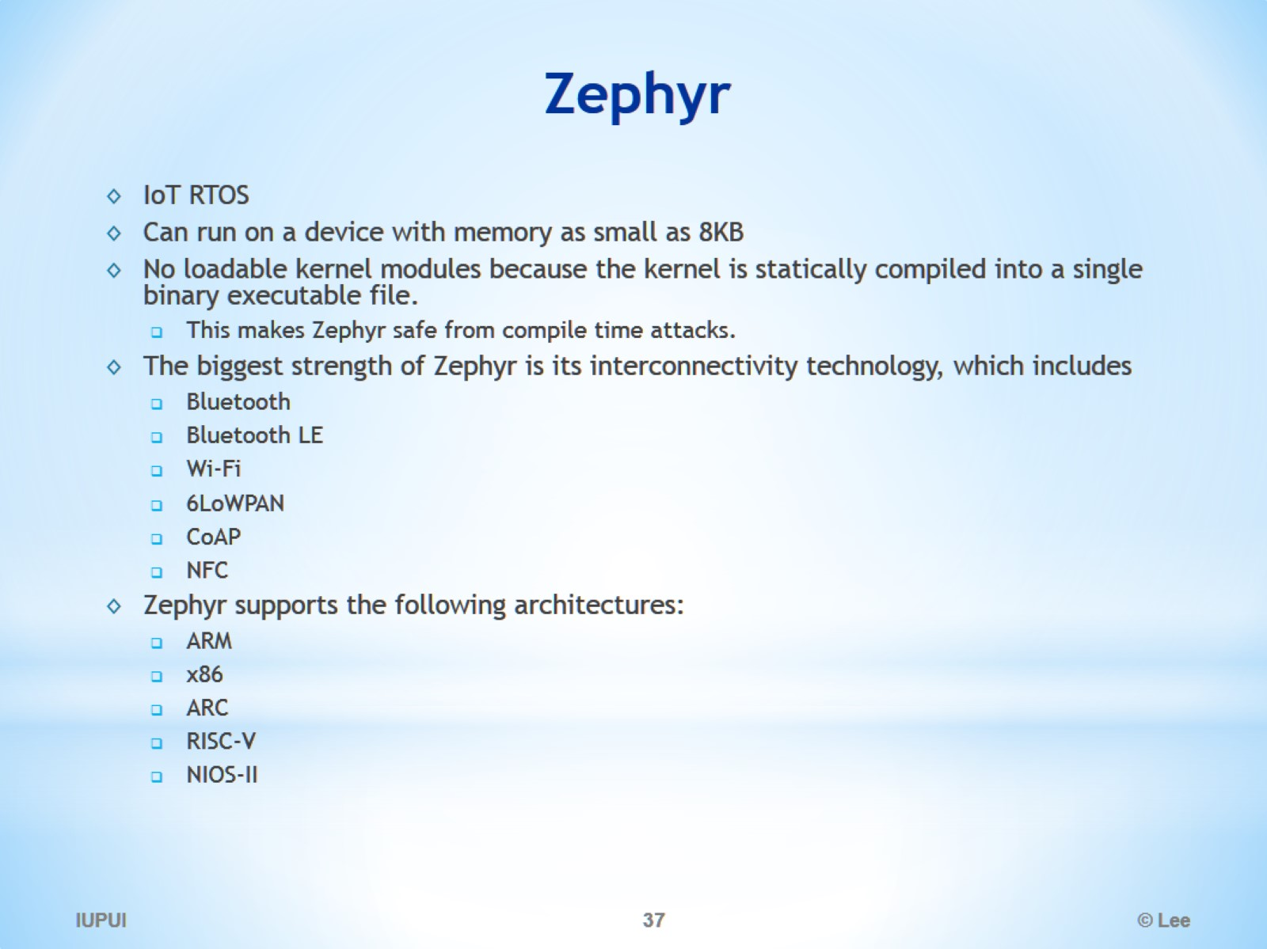
Zephyr

